Slide 1
HPGe MCNP Automated Parametric Optimization Model
Air Force Institute of Technology
6 December, 2017

Slide 2
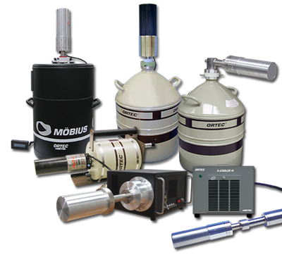
Overview
Project Goals
Previous Work
Experiment
MCNP Model
Parametric Optimization Code
Results
Future Work

Slide 3
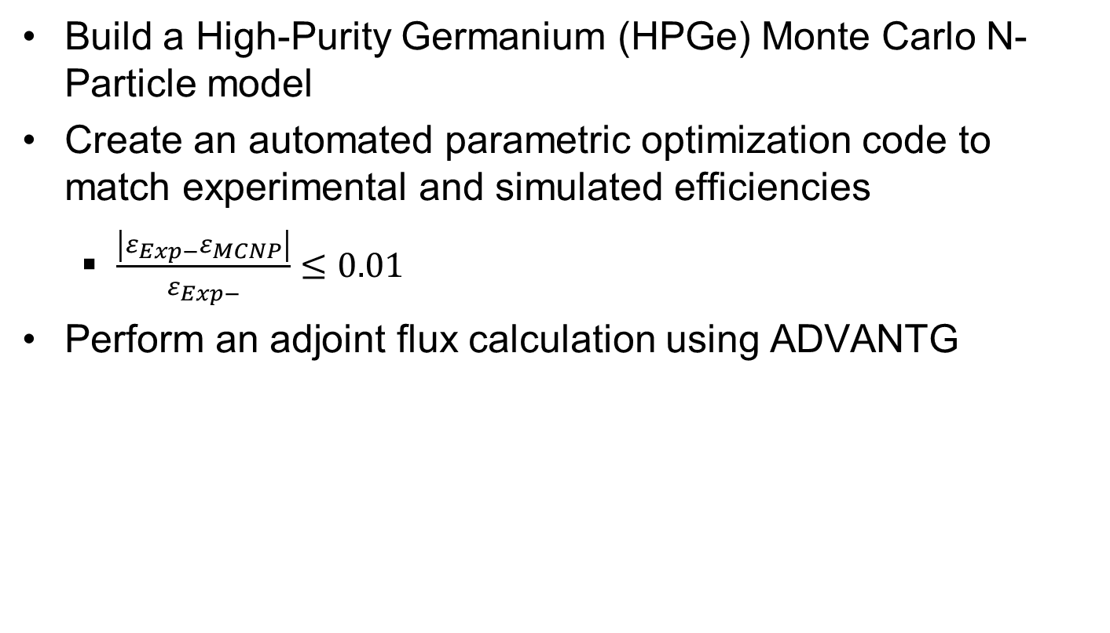
Project Goal
Build a High-Purity Germanium (HPGe) Monte Carlo N-Particle model
Create an automated parametric optimization code to match experimental and simulated efficiencies
$\frac{\left|ε_{Exp−}ε_{MCNP}\right|}{ε_{Exp−}}≤0.01$
Perform an adjoint flux calculation using ADVANTG

Slide 4
Previous Work
Manufacturer provided dimensions are often times not sufficient for developing models. ^{[1]}
Published relative differences between experimental and Monte Carlo simulated absolute efficiencies range from around 10% to as low as 0.2%. ^{[2][3]}
Dead layer thickness and the active volume may change over time. ^{[4]}
Notes:
[1] Ronald Keyser
[2] https://cyclotron.tamu.edu/progress-reports/2002-2003/1%20Nuclear%20Structure,%20Fundamental%20Interactions,%20and%20Astrophysics/I-28%20Precise%20efficiency%20calibration%20of%20an%20HPGe%20detector.pdf
[3]http://www.iaea.org/inis/collection/NCLCollectionStore/_Public/42/107/42107607.pdf
[4] Knoll’s

Slide 5
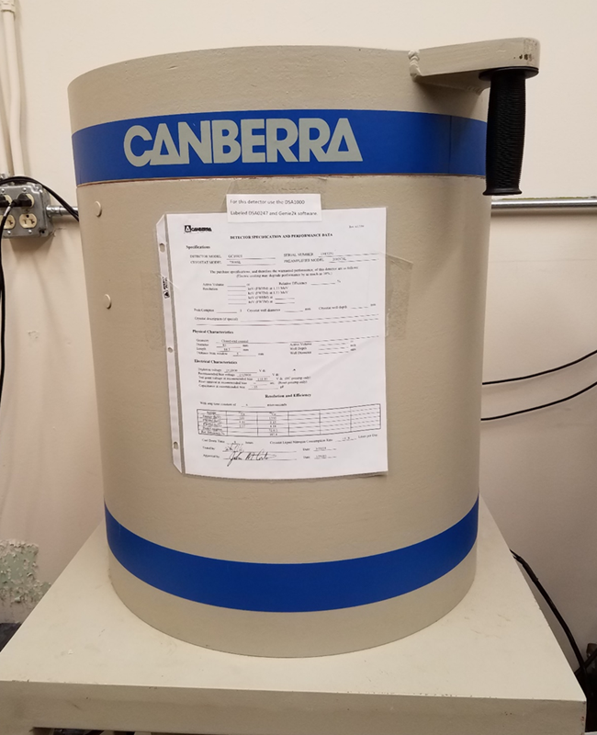
Experiment
Performed by Lt Col O’Day (April 2017)
Eckert & Ziegler Multi-nuclide source
Count time = 24 hours
5 different source positions
Notes:
[1] Ronald Keyser
[2] https://cyclotron.tamu.edu/progress-reports/2002-2003/1%20Nuclear%20Structure,%20Fundamental%20Interactions,%20and%20Astrophysics/I-28%20Precise%20efficiency%20calibration%20of%20an%20HPGe%20detector.pdf
[3]http://www.iaea.org/inis/collection/NCLCollectionStore/_Public/42/107/42107607.pdf
[4] Knoll’s

Slide 6


Detector Specifications
Canberra Standard Electrode Ge Detector (SEGe)
Model Number: GC10021
Relative Efficiency $≥$ 100 %
Resolution: 1.20 keV at 122 keV and 2.1 at 1.3 MeV
Coaxial Configuration
P-Type
γ
p+ contact
n+ contact
e-
Notes:
[1] Ronald Keyser
[2] https://cyclotron.tamu.edu/progress-reports/2002-2003/1%20Nuclear%20Structure,%20Fundamental%20Interactions,%20and%20Astrophysics/I-28%20Precise%20efficiency%20calibration%20of%20an%20HPGe%20detector.pdf
[3]http://www.iaea.org/inis/collection/NCLCollectionStore/_Public/42/107/42107607.pdf
[4] Knoll’s

Slide 7
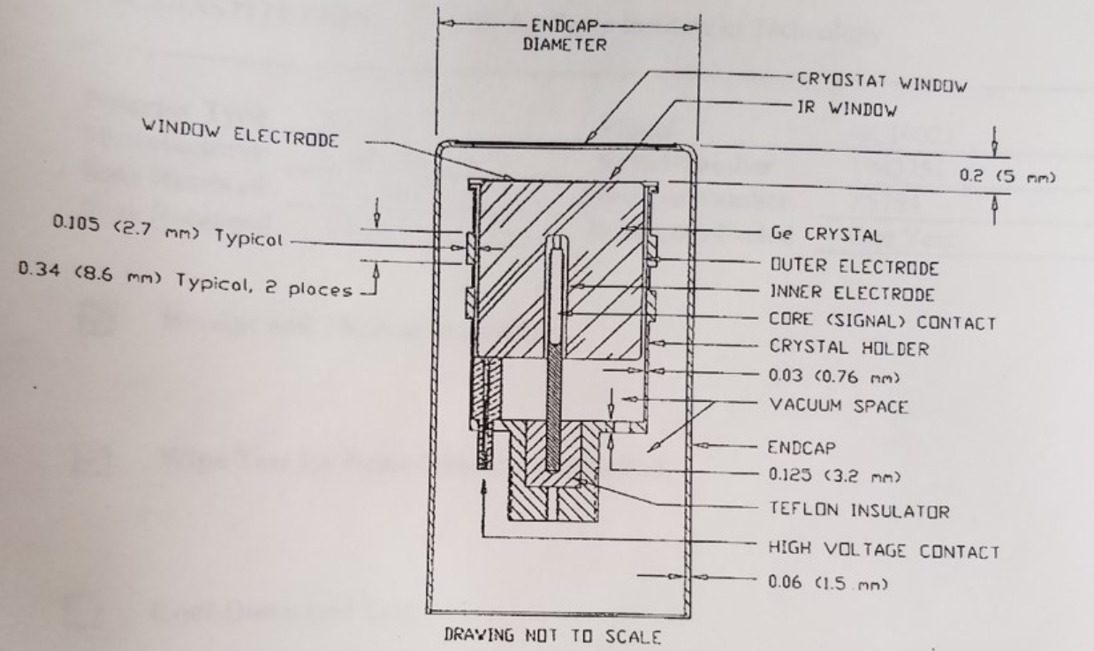
Detector Specifications
Notes:
[1] Ronald Keyser
[2] https://cyclotron.tamu.edu/progress-reports/2002-2003/1%20Nuclear%20Structure,%20Fundamental%20Interactions,%20and%20Astrophysics/I-28%20Precise%20efficiency%20calibration%20of%20an%20HPGe%20detector.pdf
[3]http://www.iaea.org/inis/collection/NCLCollectionStore/_Public/42/107/42107607.pdf
[4] Knoll’s

Slide 8
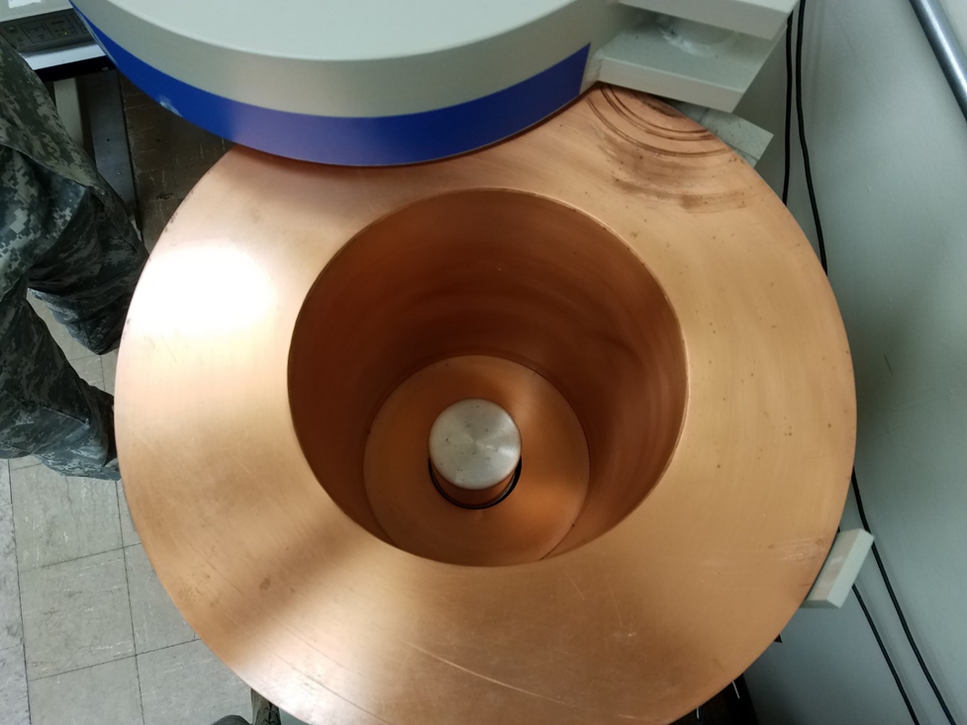
Experimental Setup
Notes:
[1] Ronald Keyser
[2] https://cyclotron.tamu.edu/progress-reports/2002-2003/1%20Nuclear%20Structure,%20Fundamental%20Interactions,%20and%20Astrophysics/I-28%20Precise%20efficiency%20calibration%20of%20an%20HPGe%20detector.pdf
[3]http://www.iaea.org/inis/collection/NCLCollectionStore/_Public/42/107/42107607.pdf
[4] Knoll’s

Slide 9
Experimental Setup
Gamma-Ray Energy [keV] | Nuclide | Activity [µCi] | Gammas per Second
60 | Am-241 | 0.02941 | 391.7
88 | Cd-109 | 0.2707 | 363.6
122 | Co-157 | 0.01019 | 322.7
159 | Te-123 | 0.01403 | 436.1
320 | Cr-51 | 0.3389 | 1236
392 | Sn-113 | 0.05109 | 1227
514 | Sr-85 | 0.06171 | 2247
662 | Cs-137 | 0.04325 | 1362
898 | Y-88 | 0.09633 | 3347
1173 | Co-60 | 0.05101 | 1885
1333 | Co-60 | 0.05101 | 1887
1836 | Y-88 | 0.09622 | 3539
* Energies were kept constant with manufacturer provided documentation
* Source uncertainty for each energy was 3.1%
Notes:
[1] Ronald Keyser
[2] https://cyclotron.tamu.edu/progress-reports/2002-2003/1%20Nuclear%20Structure,%20Fundamental%20Interactions,%20and%20Astrophysics/I-28%20Precise%20efficiency%20calibration%20of%20an%20HPGe%20detector.pdf
[3]http://www.iaea.org/inis/collection/NCLCollectionStore/_Public/42/107/42107607.pdf
[4] Knoll’s

Slide 10
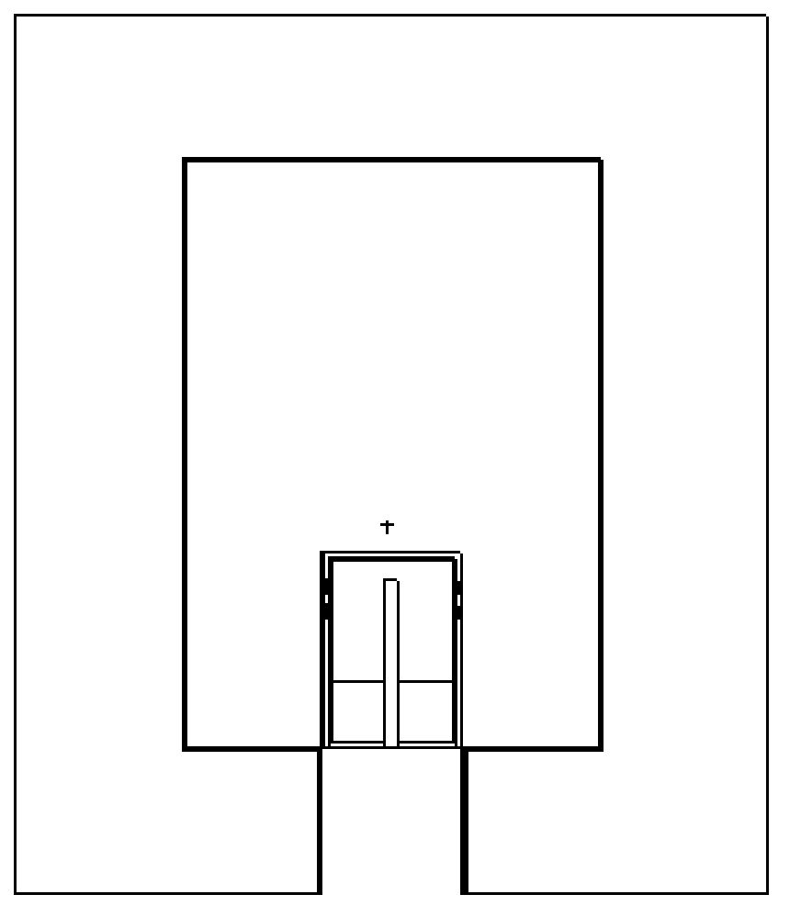
Experimental Setup
y-axis
G
5
3
A – 13.7385 cm
B – 3.48 cm
C – 4.8885 cm
D – 7.6 cm
E – 20.735 cm
F – 29.7385 cm
G – 9.78 cm
E
F
1
B
2
A
C
4
D
X-axis
(0,0)
Notes:
[1] Ronald Keyser
[2] https://cyclotron.tamu.edu/progress-reports/2002-2003/1%20Nuclear%20Structure,%20Fundamental%20Interactions,%20and%20Astrophysics/I-28%20Precise%20efficiency%20calibration%20of%20an%20HPGe%20detector.pdf
[3]http://www.iaea.org/inis/collection/NCLCollectionStore/_Public/42/107/42107607.pdf
[4] Knoll’s

Slide 11
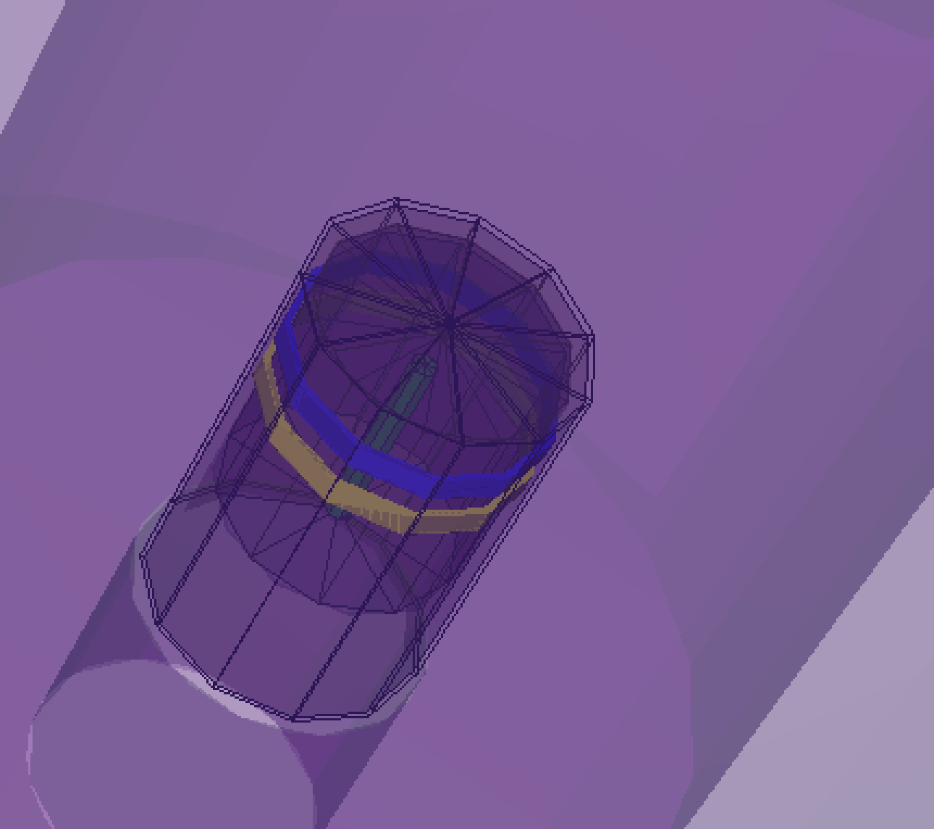
MCNP Model

Slide 12
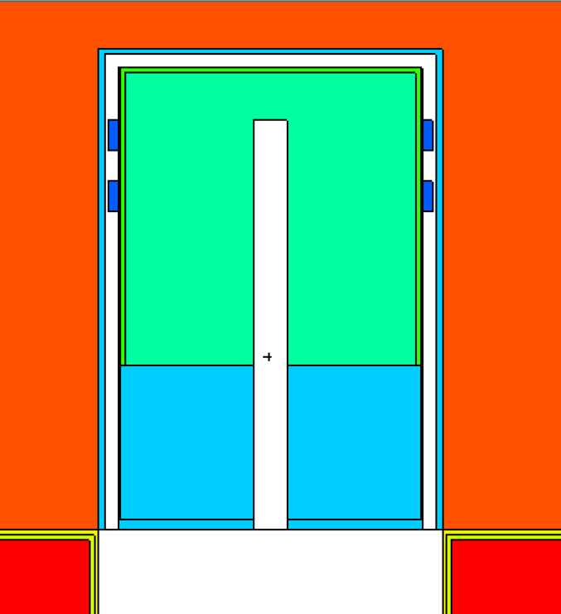
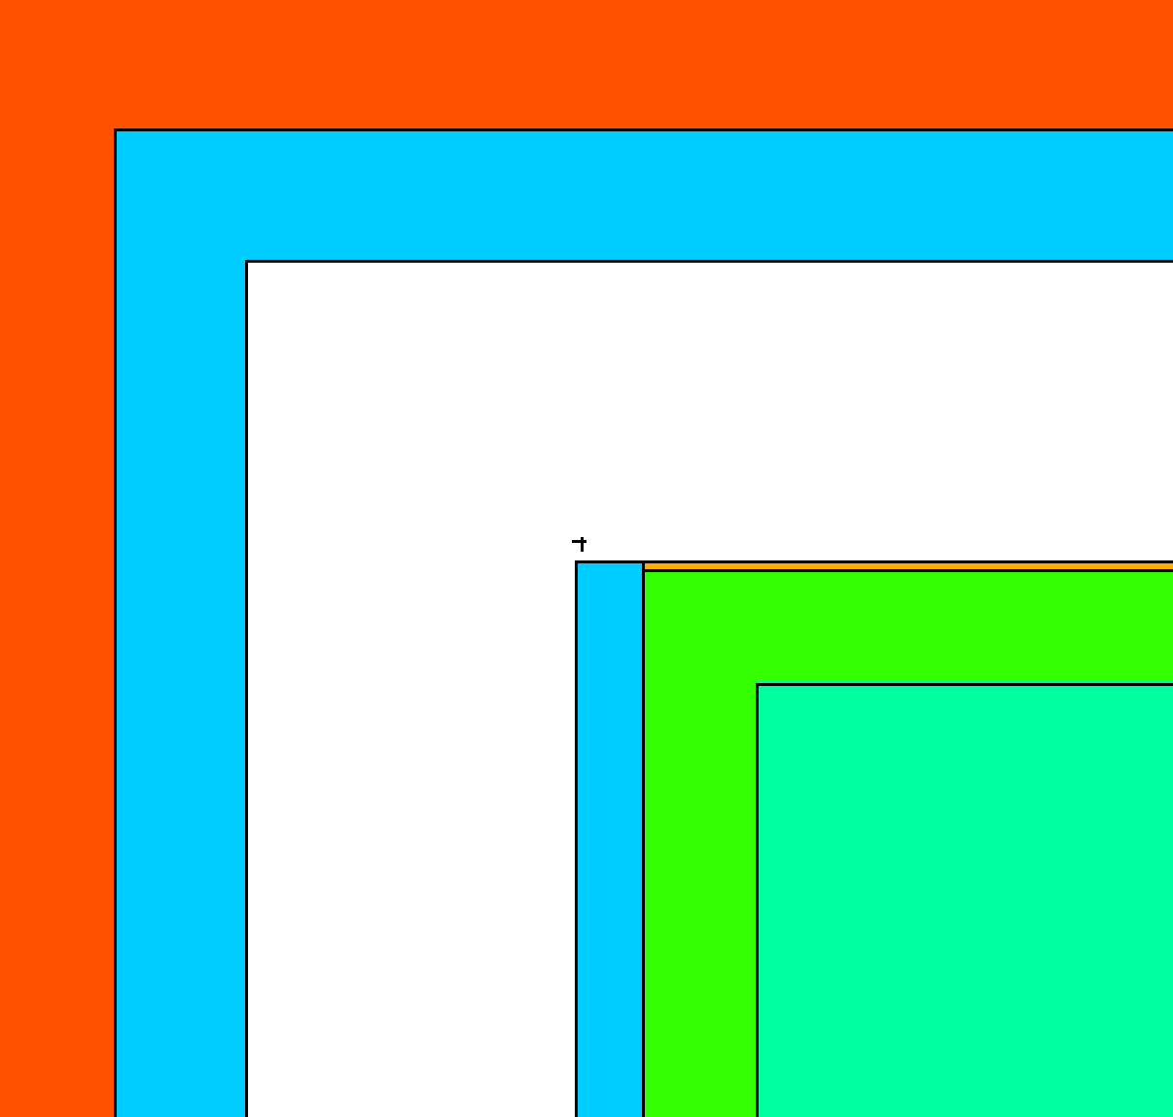
Geometry
Origin: Centered/Bottom of shielding case
Cylinders (~14 CZs)
Planes (~20 PZs)

Slide 13
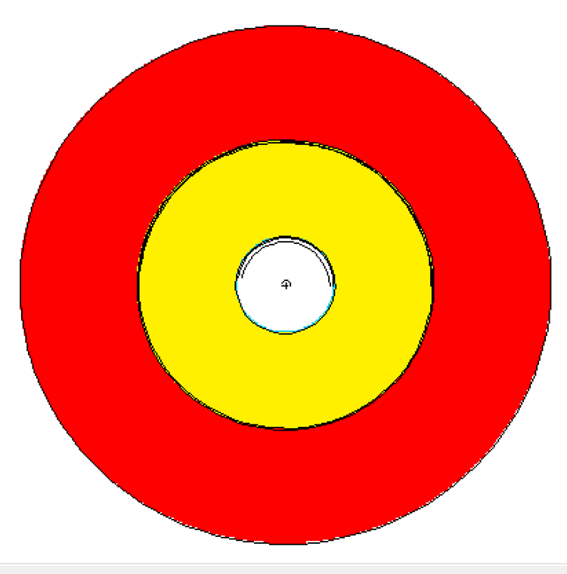
Geometry
Top View:

Slide 14
Materials
Material | Density [g/cm³] | Component(s)
Mylar | 1.38 | IR Window
Brass | 8.41 | Metal Clasps
Aluminum | 2.7 | Detector Housing and Casing
Germanium | 5.32 | Ge Crystal
Lithium | 0.534 | Outer Deadlayer
Boron | 2.73 | Inner Deadlayer
Copper | 8.96 | Shield Lining
Tin | 7.31 | Shield Lining
Kapton Film | 1.42 | IR Window
Air | 0.001224 | Shielding Chamber
Lead | 11.34 | Shielding
Acrylic Glass | 1.19 | Source Encapsulation
Vacuum | --- | Coaxial Space
* All materials from LANLs ACE Data Tables, or PNNLs Compendium of Material Composition Data for Radiation Transport Modeling

Slide 15
Photon Transport
Only photons
5 MeV upper limit
No Bremsstrahlung
No Coherent scattering
No photofission
Doppler broadening on
No photofission
Notes:
Cite manual, primer, and PNNL materials

Slide 16
Source Definition
Isotropic point source
11 discrete energies
10⁶ source particles
Gaussian broadening off
Tallies:
F8 – Energy Deposition Tally
Ge Crystal (Cell 3)
8192 bins (10⁻⁵ - 3.14344 MeV)

Slide 17
Parameters to Adjust
Isotropic point source
11 discrete energies
10⁶ source particles
Gaussian broadening off
Tallies:
F8 – Energy Deposition Tally
Ge Crystal (Cell 3)
8192 bins (10⁻⁵ - 3.14344 MeV)

Slide 18
Summary
Background
MCNP Model
Parametric Optimization Code
Results
Future Work

Slide 19
Acknowledgements
Captain James Bevins, AFIT
Lt Colonel Buck O’Day, AFIT
Edna’s Model
Capt Bevins Model

Slide 20
References
[1] Ronald Keyser
[2] https://cyclotron.tamu.edu/progress-reports/2002-2003/1%20Nuclear%20Structure,%20Fundamental%20Interactions,%20and%20Astrophysics/I-28%20Precise%20efficiency%20calibration%20of%20an%20HPGe%20detector.pdf
[3]http://www.iaea.org/inis/collection/NCLCollectionStore/_Public/42/107/42107607.pdf
[4] Knoll’s
[5] Standard Electrode Coaxial Ge Detectors

Slide 21
Questions?

